Slide 1


Slide 2

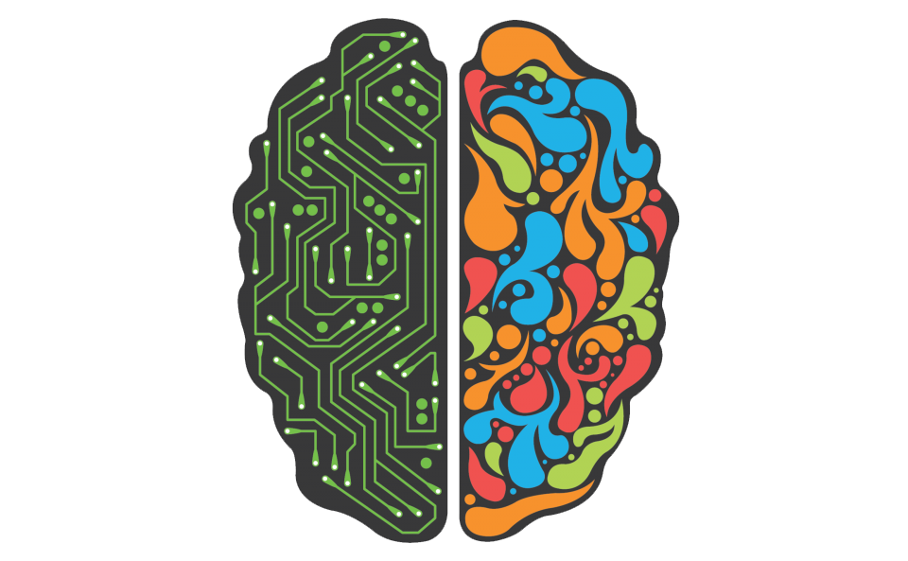
Introduction Practical
Deep Learning

Slide 3


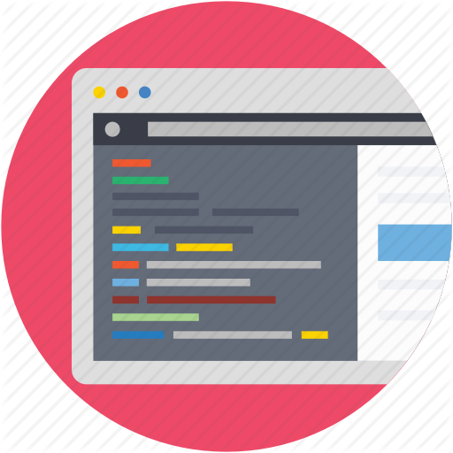


Programming Language
Deep Learning Library
Outline
Development Environment (IDE)
Course Materials
DL Application and Results

Slide 4
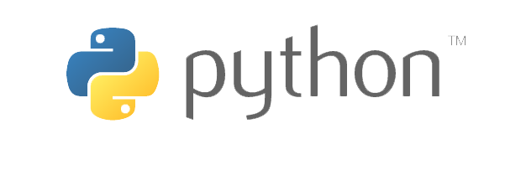
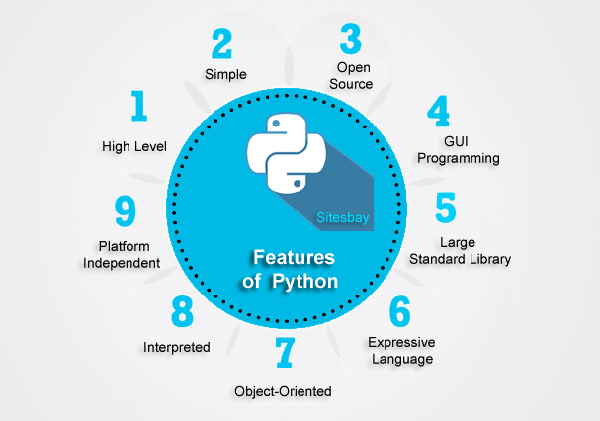
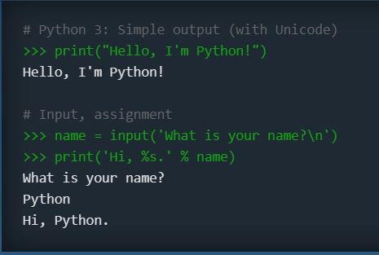
https://www.python.org/

Slide 5
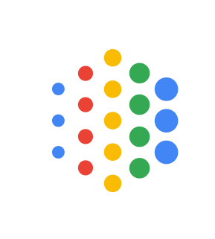






Deep Learning Library

Slide 6
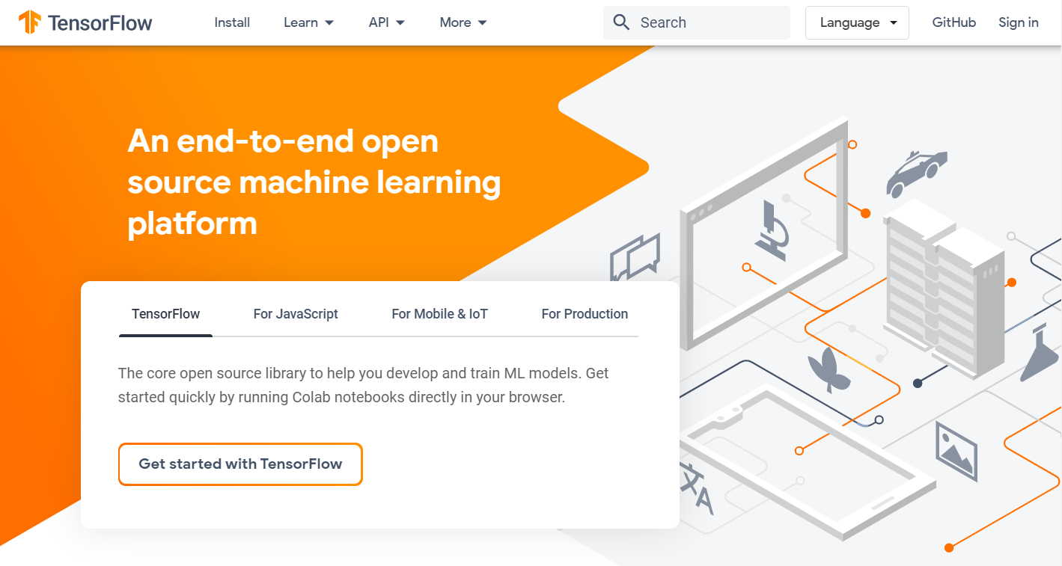

Slide 7

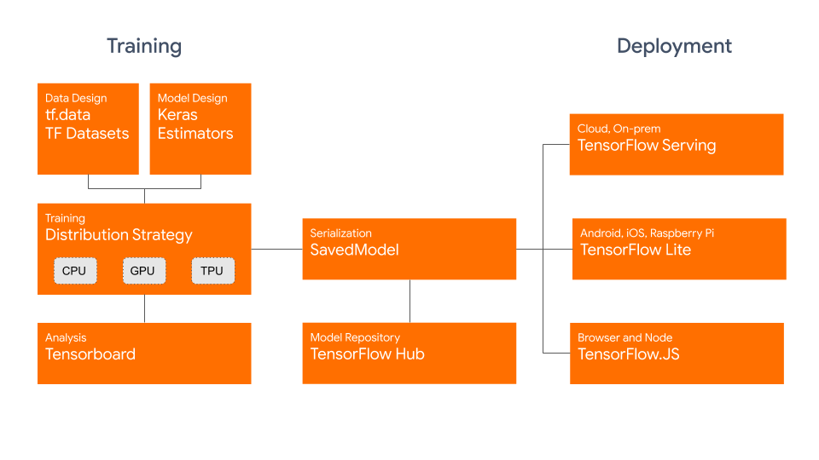

https://www.udacity.com/course/intro-to-tensorflow-for-deep-learning--ud187
https://www.coursera.org/specializations/tensorflow-in-practice

Slide 8
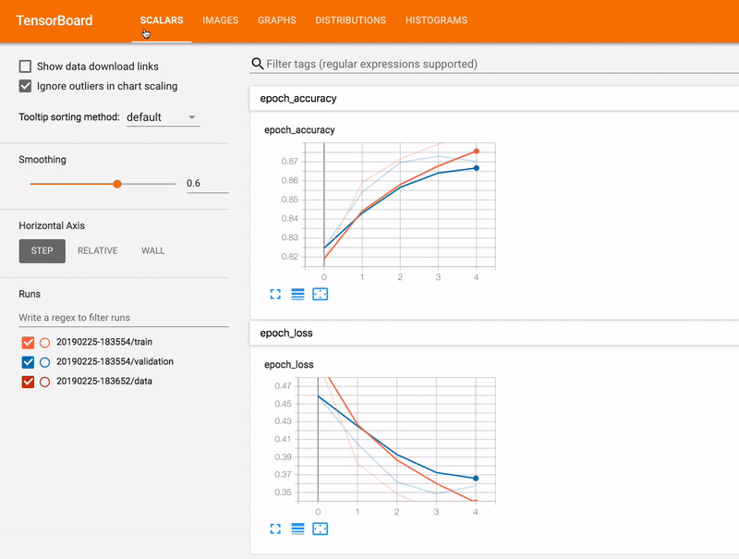
TensorBoard: TensorFlow's visualization toolkit

Slide 9
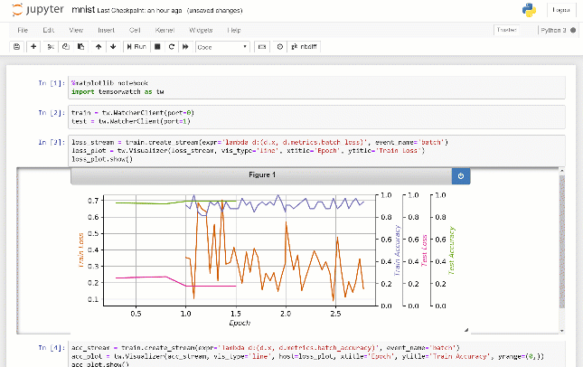
TensorWatch: Debugging, monitoring and visualization for Python Machine Learning and Data Science
https://github.com/microsoft/tensorwatch

Slide 10

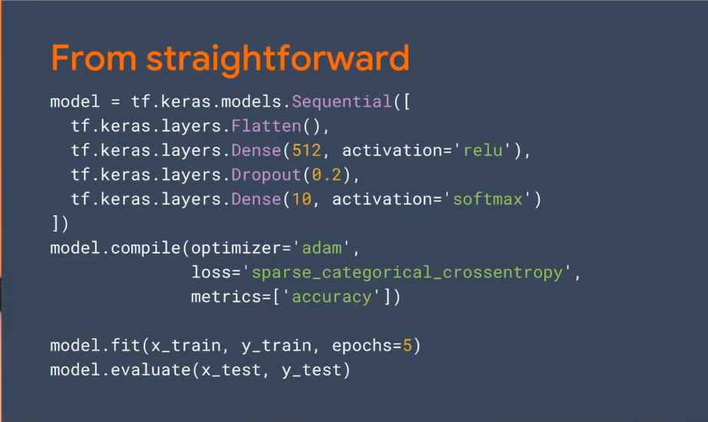
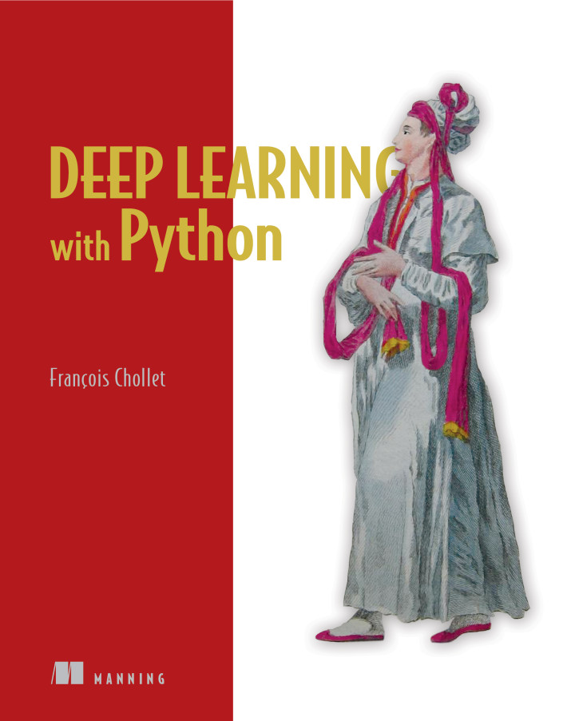
Keras is a powerful and easy-to-use free open source Python library for developing and evaluating deep learning models
from tensorflow import keras
https://keras.io/
https://www.manning.com/books/deep-learning-with-python

Slide 11
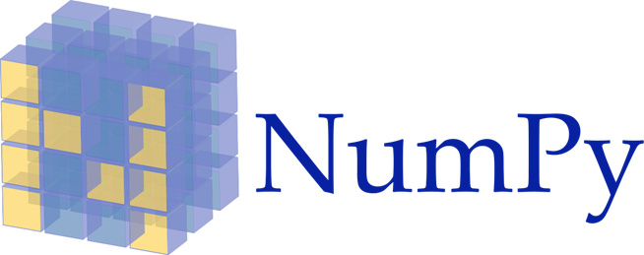

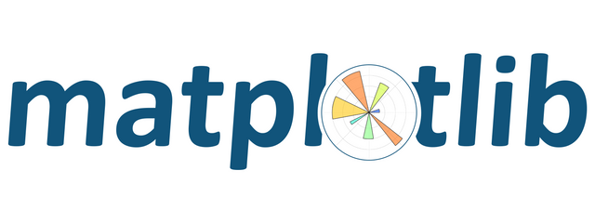
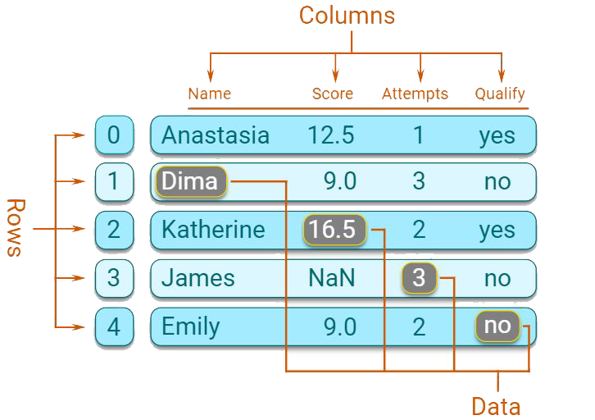
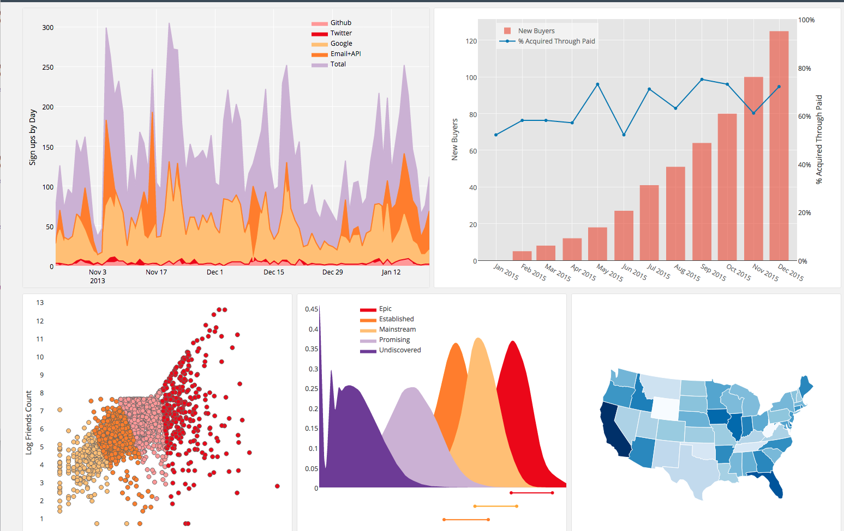
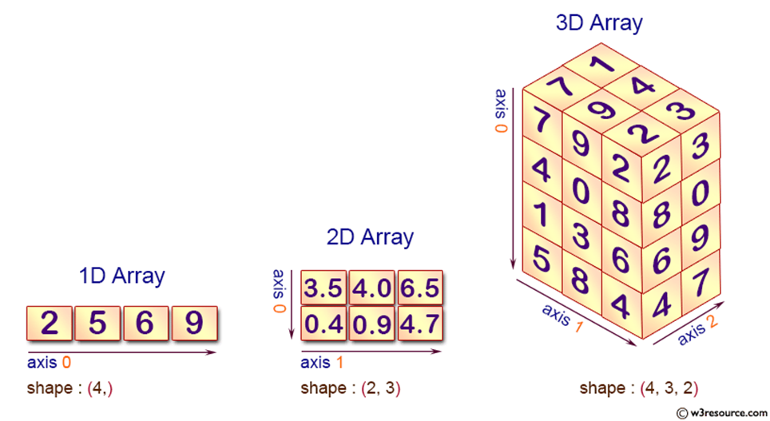


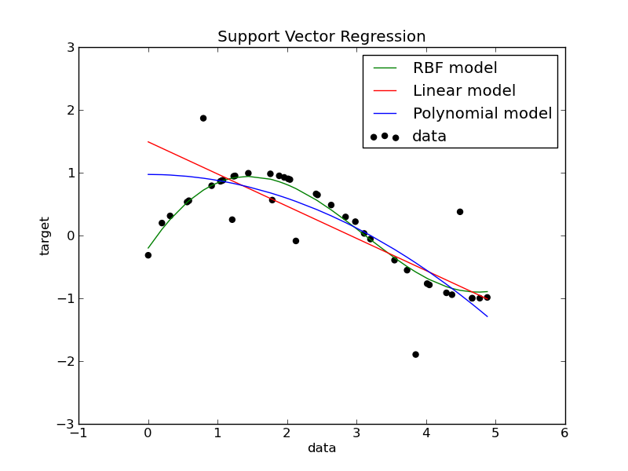
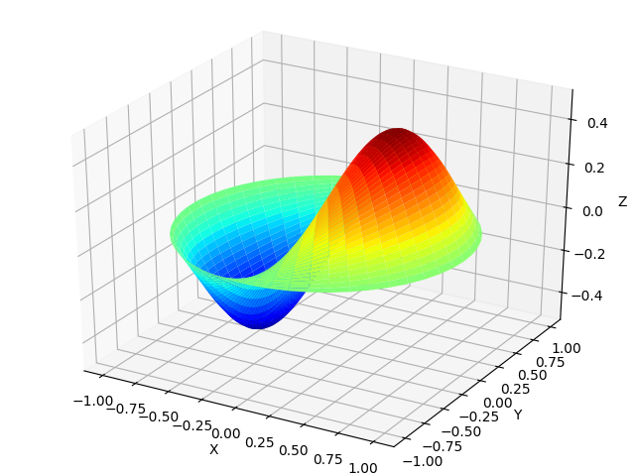
Data Scientists and Machine learning Tools

Slide 12
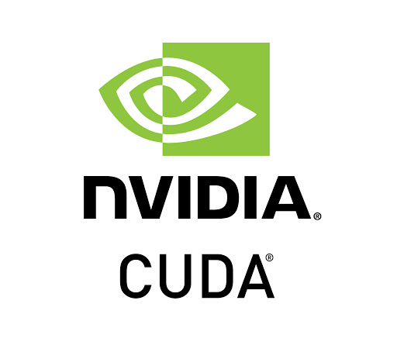
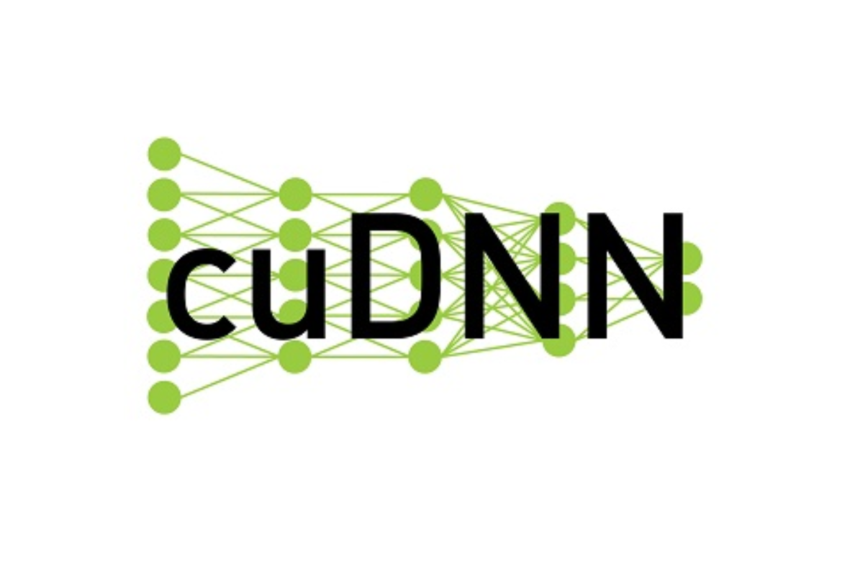
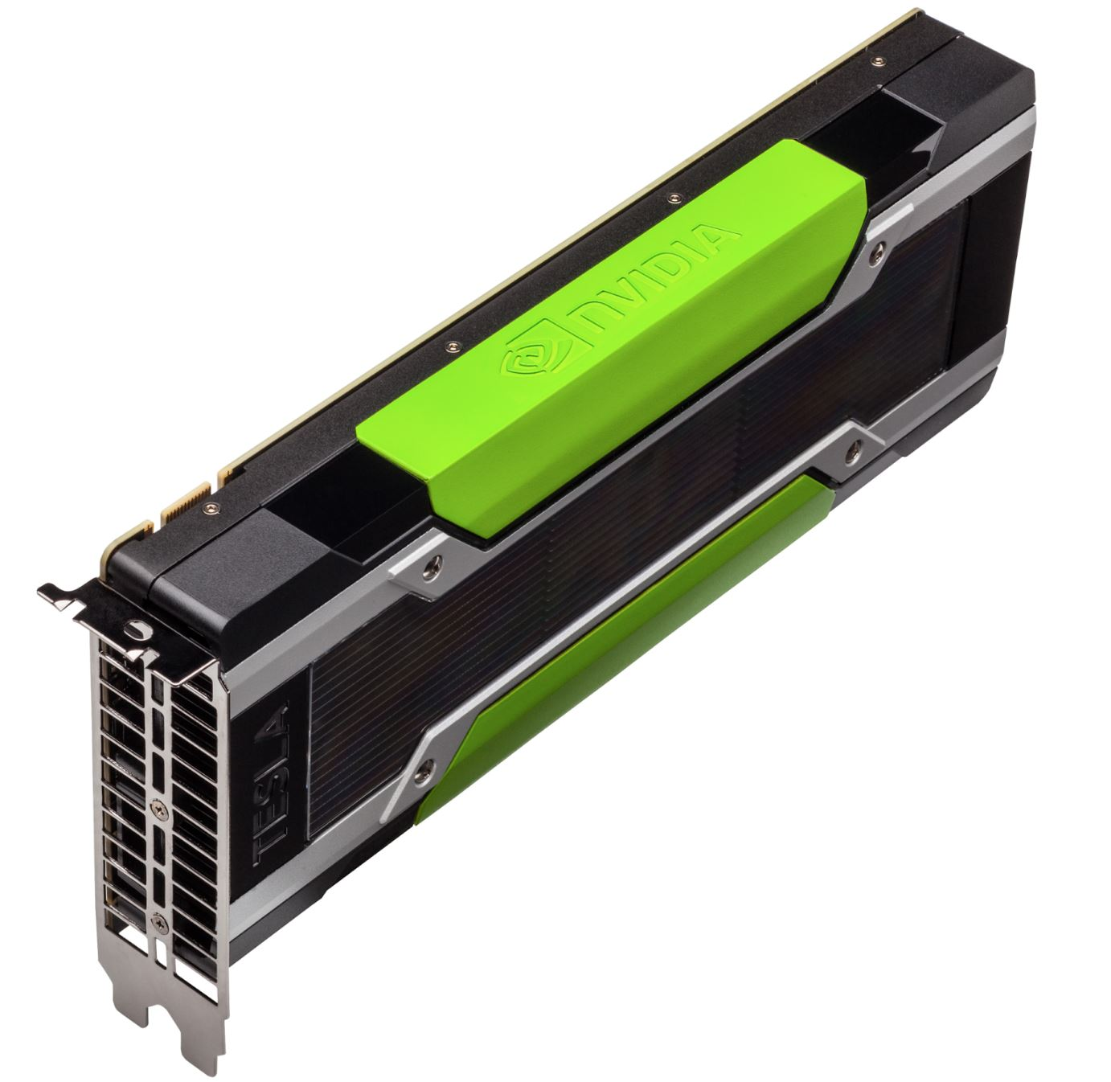
GPU and TPU

Slide 13



Ways to Running Deep Learning Model
On your Laptop
Professors' Lab
Google Colab

Slide 14
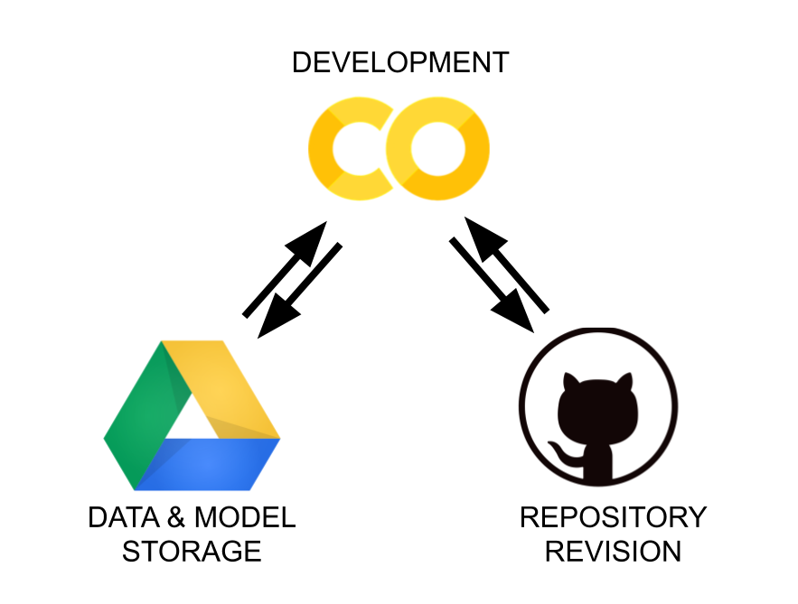
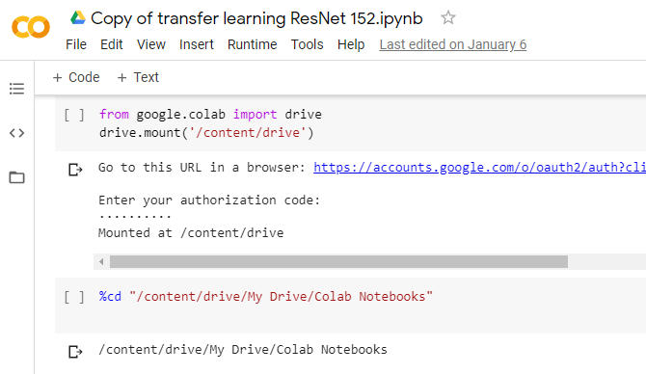
Google Colab
https://colab.research.google.com/
Nvidia Tesla T4
RAM 12 GB
12 hours

Slide 15

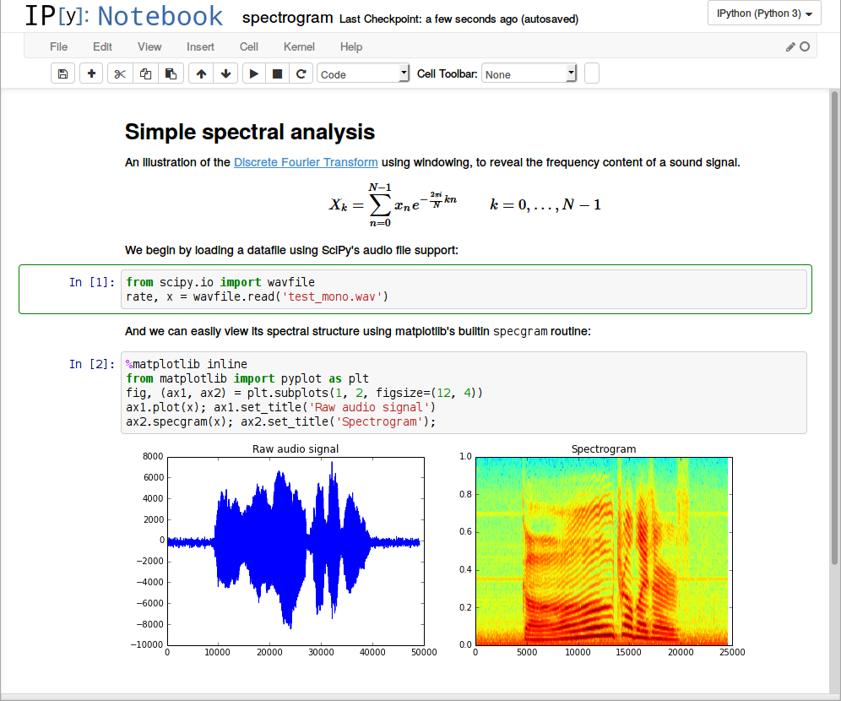
https://jupyter.org/

Slide 16

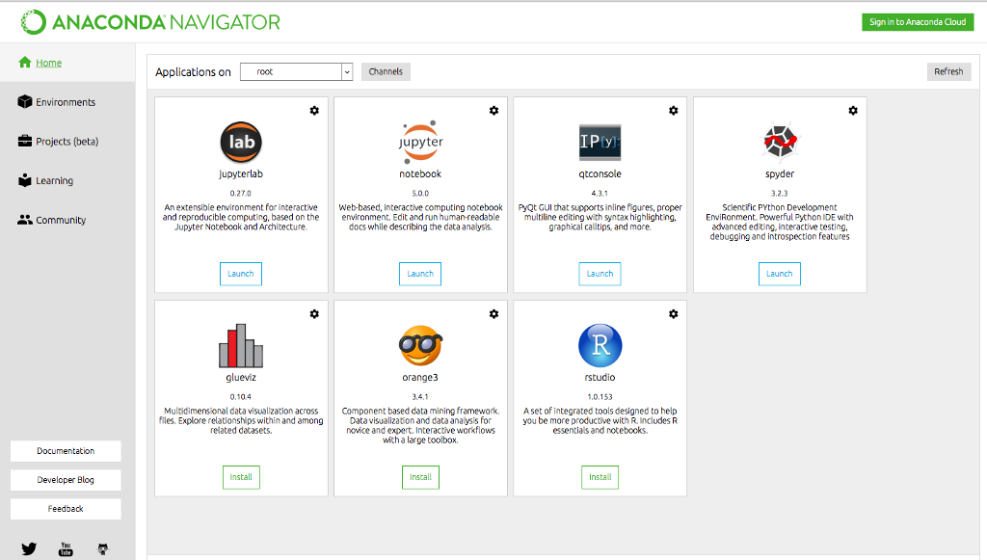
https://www.anaconda.com/

Slide 17



Popular IDE
Pycharm
Visual Studio Code
Spyder

Slide 18
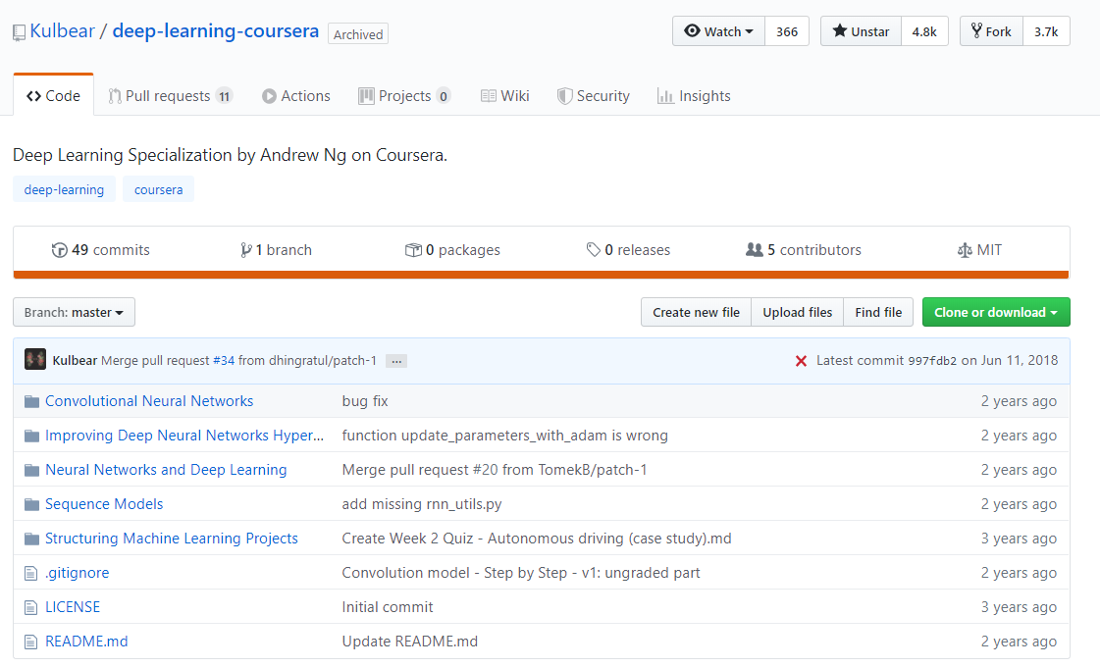
Materials: Deep Learning Specialization by Andrew Ng on Coursera.
https://github.com/Kulbear/deep-learning-coursera
https://www.coursera.org/specializations/deep-learning

Slide 19

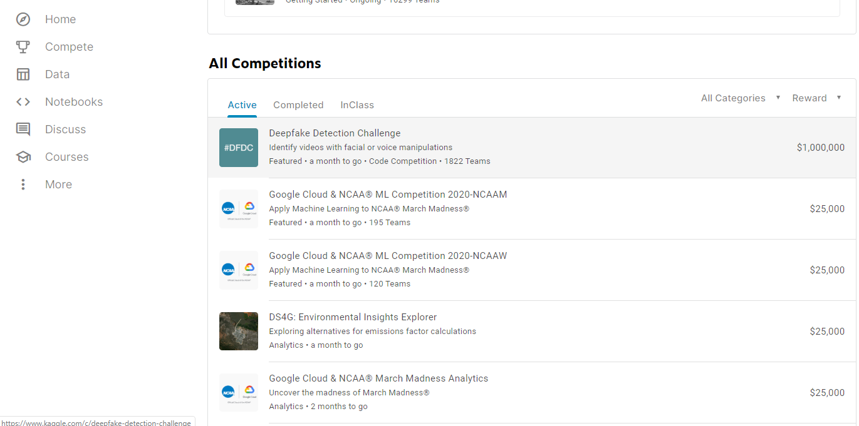
In Class Competitions
https://www.kaggle.com/competitions

Slide 20
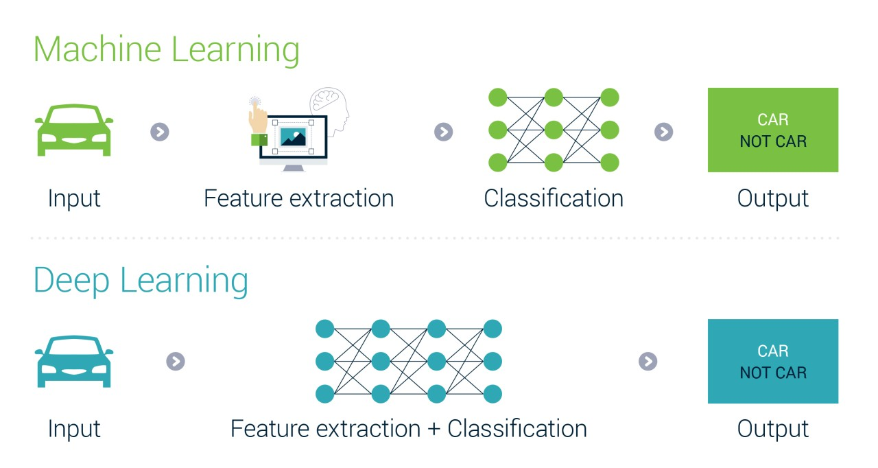
machine learning VS deep learning

Slide 21
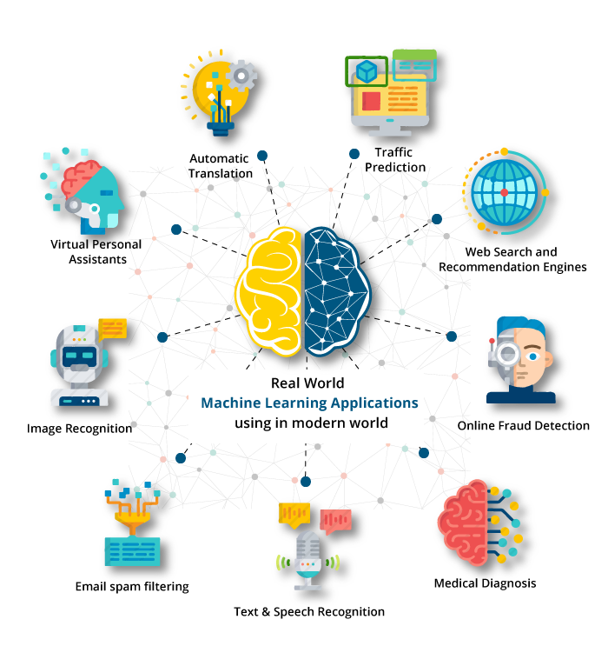
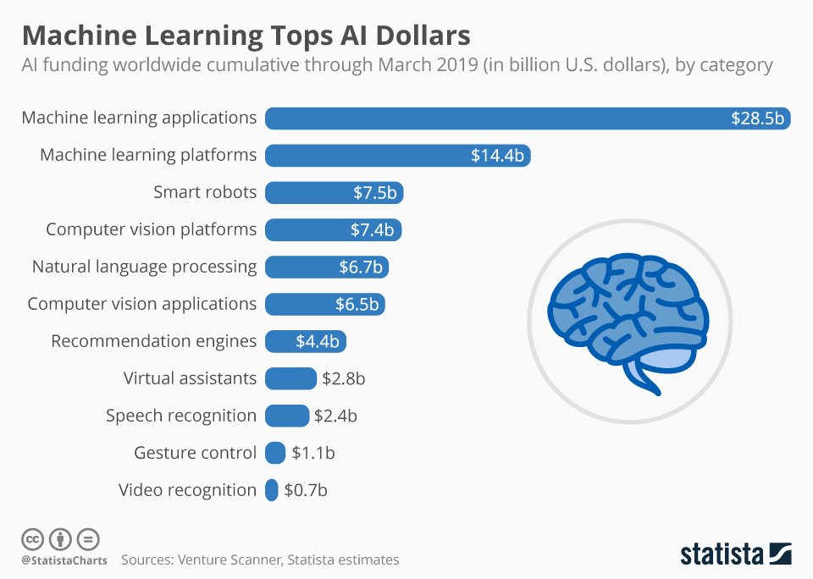
Real-world Application of Machine learning

Slide 22


Slide 23


Slide 24


